Slide 1
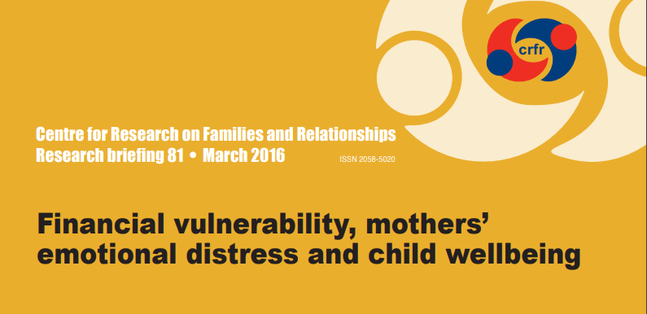
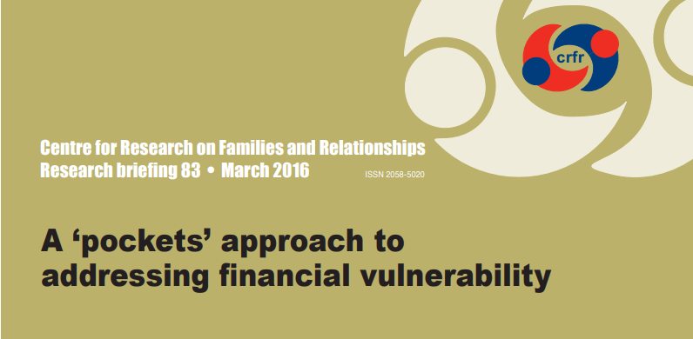
Supporting families – a rights-based approach
Professor Morag Treanor
Heriot-Watt University Parenting across Scotland conference
Edinburgh
27 August 2019

Slide 2
Outline
Financial vulnerability.
The impact of financial vulnerability on mothers’ and children’s wellbeing
Children’s rights, whose responsibility?
You can’t help children without helping their families, =>
You can’t fulfil children’s rights in isolation of their families

Slide 3
Financial vulnerability
Financial vulnerability:
differs from the objective measure of income poverty
poverty can be alleviated by borrowing but the resulting debt makes households more vulnerable
people living in poverty are more aware than professionals of the trade-offs between poverty and vulnerability
Poverty premium:
where people living in poverty cannot pay the full amount for an item, nor can they access mainstream credit, nor pay on a credit card, nor set up a direct debit and so have to pay a premium…
Example from my research in foodbanks in Dundee in April 2017 …
Notes:
These are a few of many reasons why financial vulnerability differs from the objective measure of income poverty and why it is important to try to understand how it can affect people.
Chambers (1989) in explaining financial vulnerability uses the example that poverty, as measured by low income, can
be reduced by borrowing, but that the resulting debt makes households more vulnerable in the future.
He argues that people living in poverty are more aware than poverty professionals of the trade-offs between poverty and vulnerability and that definitions of poverty conceived by professionals overlook vulnerability despite it being a primary concern to poor people themselves.

Slide 4

This was in April 2017
Notes:
Dundee story – compulsory insurance and extended warranty. I don’t know if insurance attracts interest as the website is utterly opaque.
Variable interest rates.
Dundee story of £3k washing machine.

Slide 5
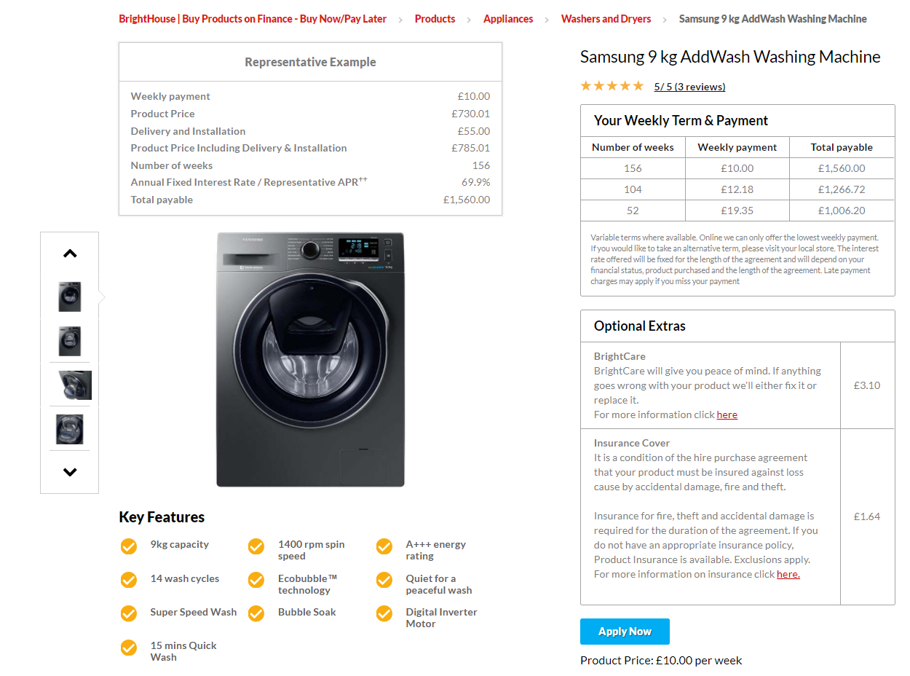
11% increase between April & August 2017
=£739.44
=£2299.44
Notes:
Brightcare and Insurance cover added. I didn’t realise that back in April 2017.
These are weekly costs over the whole period of financing.
The increase in cost is £156.

Slide 6
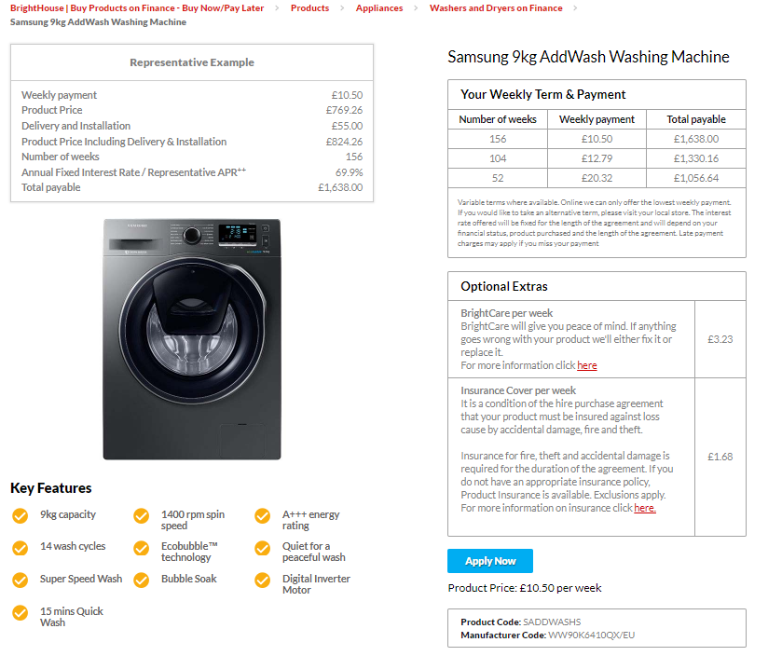
A further 5% increase between August 2017 & April 2018
=£765.96
=£2403.96
Notes:
The increase in cost is £78.
Or 16% increase in the cost alone in a year (April 2017 to April 2018).
And that isn’t looking at the optional extras which have also increased by 3.5% since August 2017 (not April).
Increases are always by £156 or £78 which lead to a £1 or £0.50 extra per week which won’t sound like a lot to people.

Slide 7
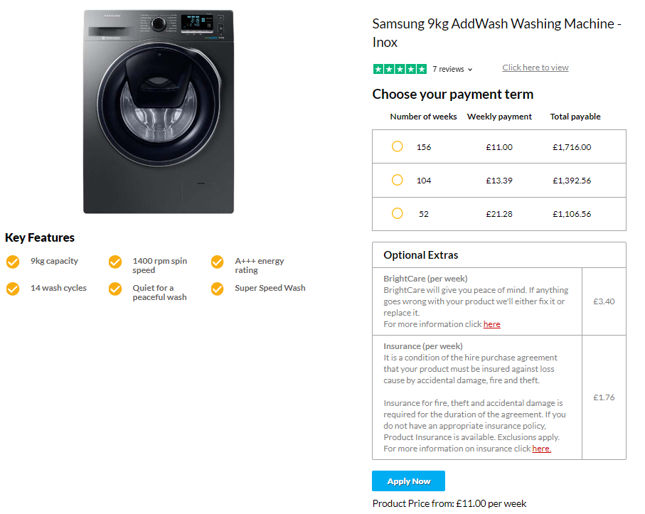
A further 5% increase between April 2018 & August 2019
=£804.96
A 20% increase in total (minus insurance) between April 2017 & August 2019
=£2520.96

Slide 8

Notes:
This is the price of the same machine in John Lewis. In Curry’s it is £419.

Slide 9

POOR FAMILIES ARE PAYING MORE THAN 10 TIMES MORE FOR A WASHING MACHINE THAN YOU OR I BECAUSE THEY CAN’T LAY THEIR HANDS ON £250.
Notes:
These are not even the cheapest washing machines in Curry’s. I sorted on the same capacity (9kg) and same rpm (1400).
If you wanted cheaper, the cheapest they have is around £160.

Slide 10
The impact of financial vulnerability on mothers’ and children’s wellbeing
Notes:
I’m about to show you how the negative effects of financial insecurity on maternal and child wellbeing exists over and above the negative effects of income and poverty.

Slide 11
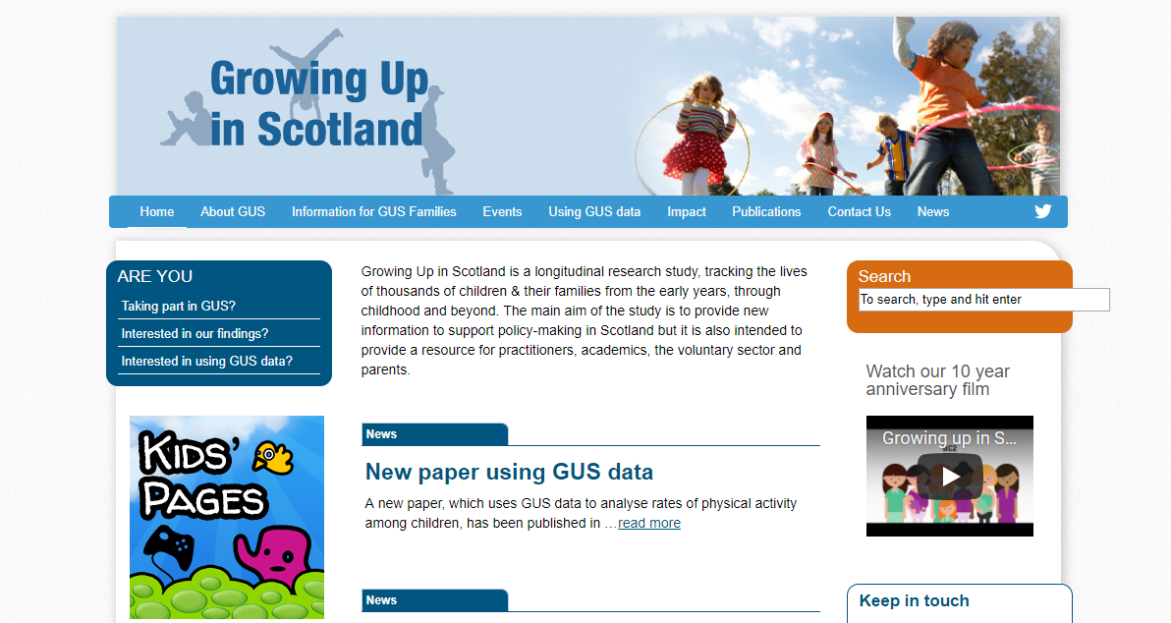
The impact of financial vulnerability on mothers’ and children’s wellbeing

Slide 12
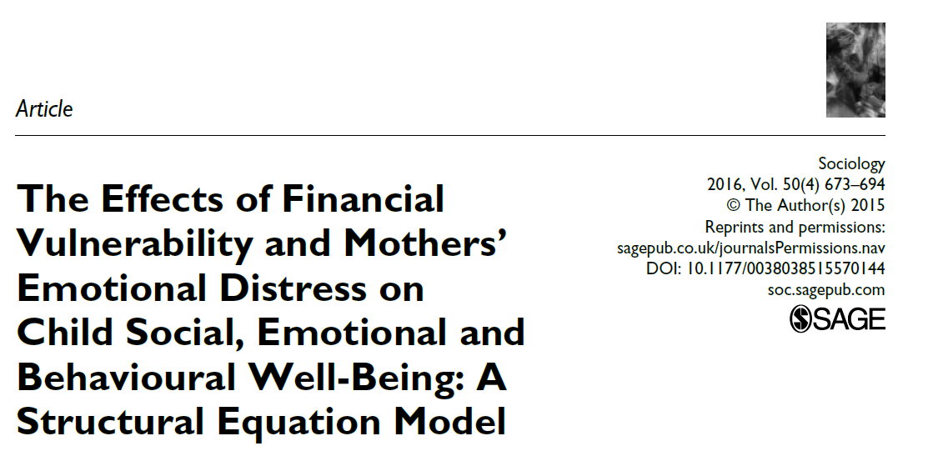

Slide 13
What variables were looked at…
Child variables:
Child wellbeing measured by the Strengths and Difficulties Questionnaire (SDQ)
Child’s Gender
Child’s Birth Order
Mothers’ variables:
Maternal Emotional Distress (SF-12)
Financial Vulnerability
Income
Family Composition
Stable couple, stable lone parent, separated couple, lone parent re-partnered, separations/re-partnerings
Maternal Education
Maternal Employment
Age of Mother at First Child’s Birth
Notes:
Family Composition:
•• ‘stable couple family’, where a couple has been together since the start of the study (reference category);
•• ‘stable lone parent family’, where the respondent is the sole adult in the household in each of the five years of the study;
•• ‘lone parents who have re-partnered’ – there is no distinction in the measure on the point at which the respondent re-partners;
•• ‘couple families who have separated’ – the same caveat applies as before; and
•• ‘separation(s) and re-partnering(s)’ – this category does not differentiate between those who may be separating and re-partnering with the same or with different partners.

Slide 14
Financial vulnerability is associated with:
not in paid
work
Low income
Separated
couple
Part-time
work
Re-partnered
Younger
mother
Notes:
Emphasise the additive nature of these variables
Emphasise what is not significant in the model: stable lone parent family; lone parents who have re-partnered; maternal education; any child variables

Slide 15
Maternal emotional distress is associated with:
Low
income
Financial vulnerability
Separated
couple
Not in paid
work
Notes:
Emphasise the additive nature of these variables
Emphasise what is not in the model: stable lone parent family; lone parents who have re-partnered; having re-partnered and separated more than once, maternal education; part-time employment; maternal age at birth of first child; any child variables.

Slide 16
Child wellbeing is associated with:
Financial
vulnerability
Separated &
repartnered
Younger
mother
Not in
paid work
Maternal emotional
distress
Standard
grade
No
qualifications
Notes:
Emphasise the additive nature of these variables
What is in the model that was not for mothers: low maternal education;
Emphasise what is not in the model: income (but will be swallowed up by FV); stable couple family; stable lone parent family; lone parents who have re-partnered; separated couple.

Slide 20
Children’s rights, whose responsibility?

Slide 21
Children’s rights, whose responsibility?
The family?
The idea of ‘the family’ is not straightforward: it is controversial.
The idea of the family has the ability to evoke more moral judgements than almost anything else we come together to do as humans (McCarthy et al., 2018).
Families are often described in binary, oppositional terms such as ‘functional’ or ‘dysfunctional’, ‘healthy’ or ‘unhealthy’ and ‘normal’ or ‘troubled’ (masking what people really mean, which is causing trouble or troublesome) (McCarthy et al., 2018).
The obligations of a ‘good’ family in the UK are: to be largely self-sufficient, to look after their children independently with minimal state involvement (with the exception of standard education and health care) (Welch, 2018).
Parents and children living in poverty, are not likely to have the resources to conform to the demands of the ideal family, and are likely to be judged not to have the ‘right’ type of family or the ‘right’ type of childhood.

Slide 22
Children’s rights, whose responsibility?
The state’s?
The Preamble to the UNCRC, states that state parties are:
…the family, as the fundamental group in society and the natural environment for the growth and well-being of all its members and particularly children, should be afforded the necessary protection and assistance so that it can fully assume its responsibilities within the community…
…that the child, for the full and harmonious development of his or her personality, should grow up in a family environment, in an atmosphere of happiness, love and understanding.

Slide 23
Child poverty, welfare reform and families

Slide 24
Austerity and welfare reform – UK level
Couple families with dependent children in Scotland losing an average of more than £1,400 a year, and lone parent families around £1,800 a year.
Tax credits cuts (only a few):
Family element removed (April 2017 - losing up to £545)
Two child limit (April 2017 - losing up to £2,780 per child a year)
Reduction in income increase disregard (April 2017 £5,000 to £2,500)
Minimum hours worked (April 2012)
Childcare costs (April 2012)
Backdating (April 2012)
Universal credit – lots!
While 9 out of 10 families with children were eligible for tax credits in 2010, and 6 out of 10 in 2015, only 5 out of 10 families with children will be eligible for universal credit by the time it is fully rolled out.
http://www.cpag.org.uk/sites/default/files/CPAG-Scot-factsheet-EWS-welfare-reform%28May17%29.pdf

Slide 25
Child Poverty Act 2017 – Delivery Plans
The Act requires the Scottish Government to produce three Delivery Plans over the period to March 2031
In preparing a delivery plan, the Scottish Ministers must, in particular, consider what (if any) measures they ought to take in relation to—
the provision of financial support for children and parents
supporting local authorities to consider the automatic payment of benefits and support,
the provision and accessibility of information, advice and assistance to parents in relation to—
social security matters
income maximisation
financial support
education
the availability and affordability of housing
the availability and affordability of childcare
the facilitation of the employment, and of the development of the skills, of parents
physical and mental health
children living in single-parent households
consulting, amongst others, such persons and organisations working with or representing parents.
A delivery plan must, in particular, set out whether, during the period of the plan for the purpose of meeting the child poverty targets, the Scottish Ministers intend to bring forward legislation to exercise the power provided for in section 24 of the Scotland Act 2016 (discretionary payments: top-up of reserved benefits)

Slide 26
First Child Poverty Delivery Plan (Every child every chance)
Published 29th March 2018:
Family income supplement
Minimum payment for the School Clothing Grant
£1 million on food insecurity during school holidays
New support for childcare after school and in the holidays.
Financial Health Check service
Grow the affordable credit sector
Best Start Grant.
Employment support for parents
Tackling low pay
Workplace equality and gender pay gap
Help with fuel poverty and housing costs
Help on income maximisation and the poverty premium
http://www.gov.scot/Resource/0053/00533606.pdf
Notes:
Income maximisation is one of the few poverty reduction strategies that affects children and families pre-, per- and post-pregnancy.
Including income maximisation allows CPPs to identify those at risk of poverty and to take preventative action, as well as to mitigate against already existing poverty
Income is brought into the local area and spent locally.

Slide 27
Conclusion
You can’t solve child poverty without increasing income and support to parents and families, similarly,
You can’t fulfil children’s rights in isolation of their families

Slide 28
Thank you for your attention. Any questions?

