Slide 1



Better Together
North Ayrshire Partnership
(0-5 Universal Early Years Service)
Delivering care together

Slide 2


Our Focus
Delivering care together

Slide 3
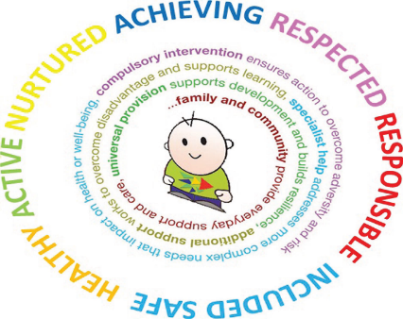
Aims
Child at the Centre
Overcoming challenges to help the child get the right help at the right time
Work in Partnership with whoever can help to address needs.
Delivering care together

Slide 4
Who are the Team?
Health Visitors (Named Person)
Early Years Social Workers
Family Nurse Partnership (NP)
Family Nurturers
Assistant Nurse Practitioners
Peri-Natal MH Nurse
Speech and Language Therapist
We Work For Families
Money Matters
Infant Feeding Nurse
Immunisation Team
Parents/Carers
Early Years Practitioners
Early Years Parenting Team
Anyone else who can contribute
Delivering care together

Slide 5
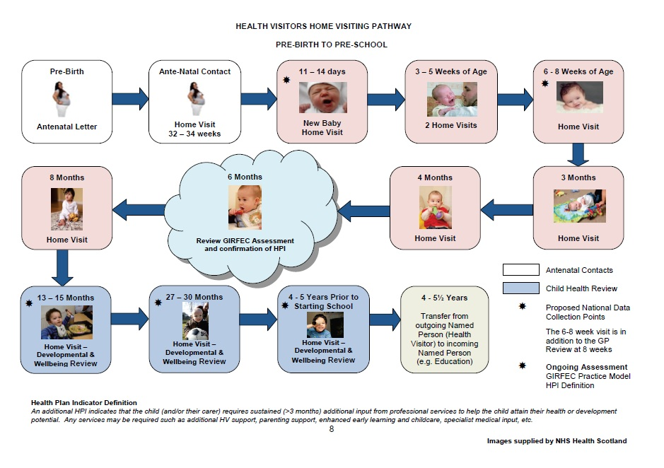
Universal Health Visiting Pathway

Slide 6





The Team works together earlier.
leads to a Plan and identifies actions
Wellbeing Assessment
Parents
Development
Health
Home
Delivering care together

Slide 7
Case Study
Family 2
Mum of two children aged 2 years and 4 months. Separated from her partner but still living in his house until she finds alternative accommodation.
The relationship with her ex partner is fractious and environment for children poor and impacting on their wellbeing.
Mum sought information about presenting homeless, but was informed potentially she and the children could be placed in a hostel until home available.
Mum stated she was feeling low, high EPDS score
Health Visitor offered assistance from The Early Years Social Worker, Peri-Natal MH Nurse and SLT
Previously mum had refused as “didn’t want social work involved in her life”.
During further visits, including after a domestic incident occurred, mum accepted support from our social worker.
A joint visit occurred and due to the family facing homelessness, the social worker made a series of enquiries and supported referral to third sector service which supports families at risk of becoming homeless.
Outcome:
Mother supported in gaining new tenancy
Positive impact on children’s wellbeing as no longer living in hostile environment, better attachment and bond
Mother supported with benefit maximisation and budgeting.
Mother mood improved, children thriving and meeting development milestones

Slide 8

Our Dream Is
Child at the Centre
Overcome challenges to help the child get the right help at the right time
Work in Partnership with whoever can help to address needs.
Progressive universal services (0-5) that is able to proportionately respond to child and family needs
Develop a workforce that has complementary skills and knowledge therefore reducing bureaucratic barriers to support
By
Delivering care together

Slide 9

Any Questions.......

