Slide 2
Foundations First: Housing as the Bedrock of Family Wellbeing
Alison Watson, Deputy Director
e:alison_watson@shelter.org.uk
t: 0844 515 2452
Twitter: @alisonj_WATSON

Slide 3
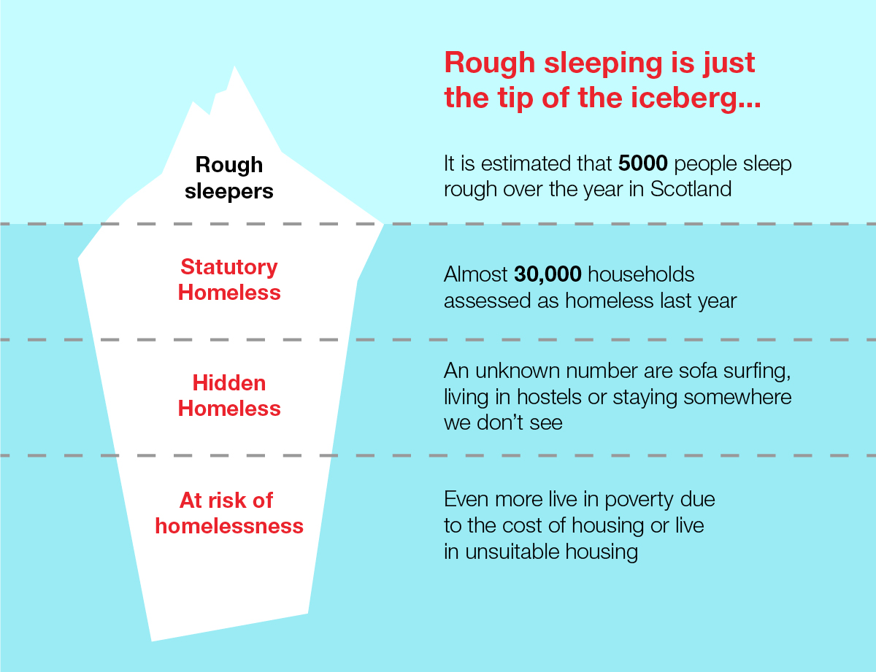
Nature and Extent of Homelessness in Scotland
On average, a household in Scotland becomes homeless every 18 minutes

Slide 4
Children and Homelessness
In 2016/17, there were 13,296 children from 9,517 families assessed as homeless – that is the equivalent of 6 children for every school in Scotland.
Nearly half of all children who are homeless are under 5 years old.
And what is the impact of homelessness on children?
Homeless children are twice as likely to suffer from poor physical or mental health.
Homeless children are twice as likely to be bullied
Their mothers are three times more likely to be clinically depressed
Homeless children miss out on a quarter of their schooling
They are twice as likely to be excluded from school and to leave school with no qualifications.
We also know that nearly 6,600 children woke up this morning in temporary accommodation – and that figure is at a 10 year high.
>1 in 10 households with children spend > than a year in temporary accommodation.

Slide 5
Housing Affordability
After meeting their housing costs, 19% of Scotland's population, or 1 million people each year, were living in poverty in 2014-17.
After housing costs, 24% of children, or 230,000 children each year, were in relative poverty in 2014-17.
Before housing costs, one fifth of all children were living in poverty, or 180,000 children. That's an extra 50,000 children in poverty, just because housing costs are unaffordable.
High housing costs mean less ‘disposable’ income to spend on household essentials such as food, gas and electricity to heat your home, or a warm winter coat for your child.
Nearly 1 in 5 children live in fuel poverty.

Slide 6
Housing Quality
1 in 10 children live in overcrowded homes
186,000 children live in homes affected by damp – that is equivalent to all of the children in Glasgow and Edinburgh combined
Moving House
Moving belongings and financial assistance
Dual rent
Setting up a home - Community Care Grants:

Slide 7
Success Factors in Supporting Families who are Homeless
  Whole family approach
  Individual – e.g. trauma informed practice
  Community – e.g. community safety; peer influences
  Structural – e.g. housing; benefits
  Shift from ‘needs’ and ‘problems’ to strengths, aspirations and goals

Slide 8
Personal Housing Planning
Participation, Choice, Control
Permanent Home
Balancing housing availability and housing aspiration and choice for families
Shared Ownership
Self-Directed & Personalised Plan
Establishes the full support needs of each family member
Builds on the assets-based approach of our support work to facilitate transition from 'service users' to 'contributors', active in the development & delivery of the service.
Co-produced Personal Housing Plan
Empowered by Peer Support
Recognises a range of factors in appraising Housing Options
Support assessments are psychologically informed
Engagement with existing services and/or Named Person
Addresses immediate, medium and longer term Housing aspirations

Slide 9
A Neighbourhood Approach
Families First - Renfrewshire
  Open access to a one stop service through drop-ins and personalised 121 support
  Time dedicated to building & fostering relationships
  Flexibility and ‘going the extra mile’
  Foundations First
  From ‘service users’ to ‘contributors’
  Fostering peer support and self-help
  Joint work to tackle issues in the local estate

